Slide 1

SUDOKU USING AI TECHNIQUES
Team Member:
Sharad Patel (00818264)
Urvang Patel (00839397)
INTRO TO AI

Slide 2

PROJECT TOPIC
Project Title:
“Solving Sudoku using AI Search Algorithms and Heuristics”

Slide 3
OBJECTIVE
To implement and evaluate AI-based search algorithms (DFS, BFS, Greedy, A*) for solving Sudoku puzzles. The aim is to measure their efficiency based on execution time and number of nodes explored, and determine which algorithm is best suited for puzzles of varying complexity.

Slide 4
DATASET
The project uses multiple manually curated Sudoku puzzles of varying difficulties (easy to hard), each stored in a 9x9 CSV format. These files simulate real-world logic puzzles and serve as input for algorithmic evaluation.

Slide 5
APPROACH
Problem Modeling: Sudoku is framed as a Constraint Satisfaction Problem (CSP) with variables, domains, and constraints.
Search Algorithms to be Implemented:
DFS (Backtracking) – baseline recursive solver.
BFS (Breadth-First Search) – level-wise exploration of possible states.
Greedy Search – selects values with least conflicts.
A* – uses cost and heuristic to guide search.

Slide 6
ALGORITHMS
01
02
03
04
DFS
(DEPTH-FIRST SEARCH)
BFS
(BREADTH-FIRST SEARCH)
GREEDY SEARCH
A* SEARCH:
Uses a heuristic to guide the search (e.g., number of empty cells).
Effective for minimizing nodes explored.
Offers best trade-off between performance and reliability.
A recursive backtracking approach.
Fast on simpler puzzles.
Backtracks when conflicts arise.
Explores all board states level-by-level.
Guarantees shortest path but uses a lot of memory.
Suitable for completeness but not efficiency.
Chooses the cell with the fewest legal options.
Very fast but may fail to backtrack effectively.
Works best on well-constrained puzzles.

Slide 7
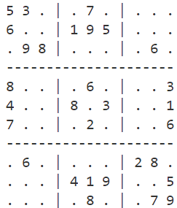
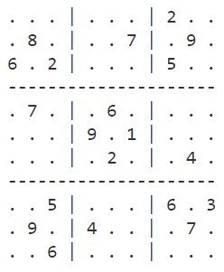
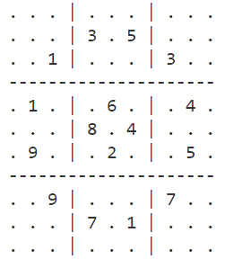
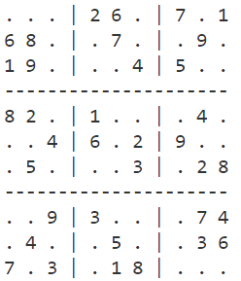
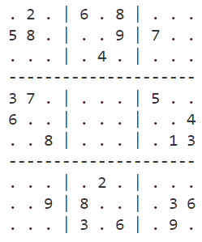
Level : Easy 1
Level : Medium 1
Level : Hard
Level : Easy 2
Level : Medium 2

Slide 8
RESULTS AND CONCLUSION:
All solvers successfully solved the puzzles.
Greedy and A* were significantly faster and more efficient than BFS.
DFS performed well on simpler puzzles but had scaling issues on harder ones.
BFS is accurate but not scalable due to memory usage.
A* provided the best balance between accuracy and performance.

Slide 9
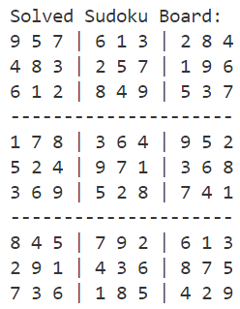
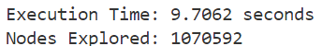
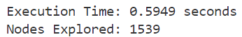
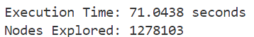
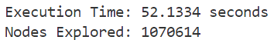
COMPARATIVE ANALYSIS
DFS:
Greedy Search:
BFS:
A*:

Slide 10
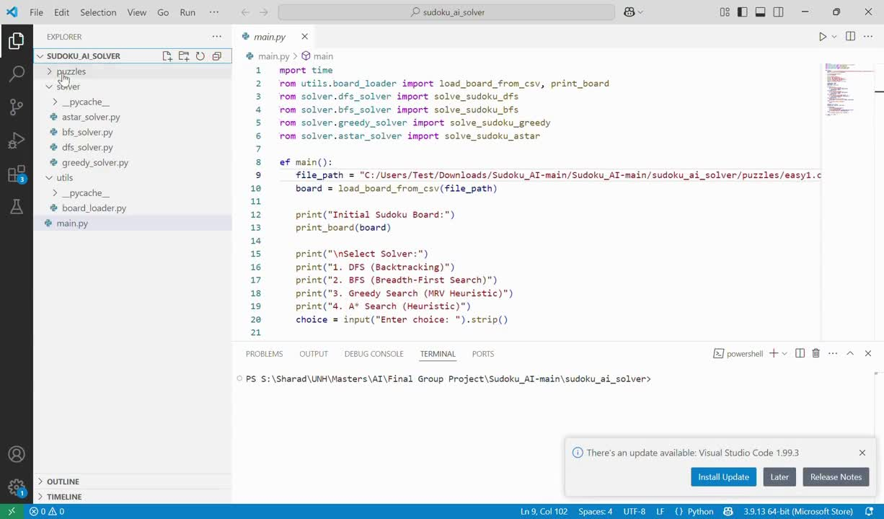
DEMO

Slide 11
THANK YOU

